Slide 1
DISASTER MENTAL HEALTH: ROLE OF PSYCHIATRIST
Dr. Aneelraj,
Post-Doctoral fellow in community mental health

Slide 2
DISASTER
A disaster is an occurrence disrupting the normal conditions of existence and causing a level of suffering that exceeds the capacity of adjustment of the affected community.

Slide 3
India is one of the most disaster prone areas of the world
DISASTER | % PRONE
Drought | 68%
Earthquakes | 58.7%
Floods | 12%
Cyclones | 8%
Landslides | 3%

Slide 4
In addition, India has increasingly become vulnerable to tsunamis since 2004.
According to India’s tenth Five Year Plan, natural disasters have affected nearly 6% of the population and 24% of deaths in Asia caused by disasters. –(Sujata Satapathy 2012)
Prevalence of mental morbidity in disaster affected population varies from 8.6 to 57.3 percent. -(Udomratn P 2008)

Slide 5
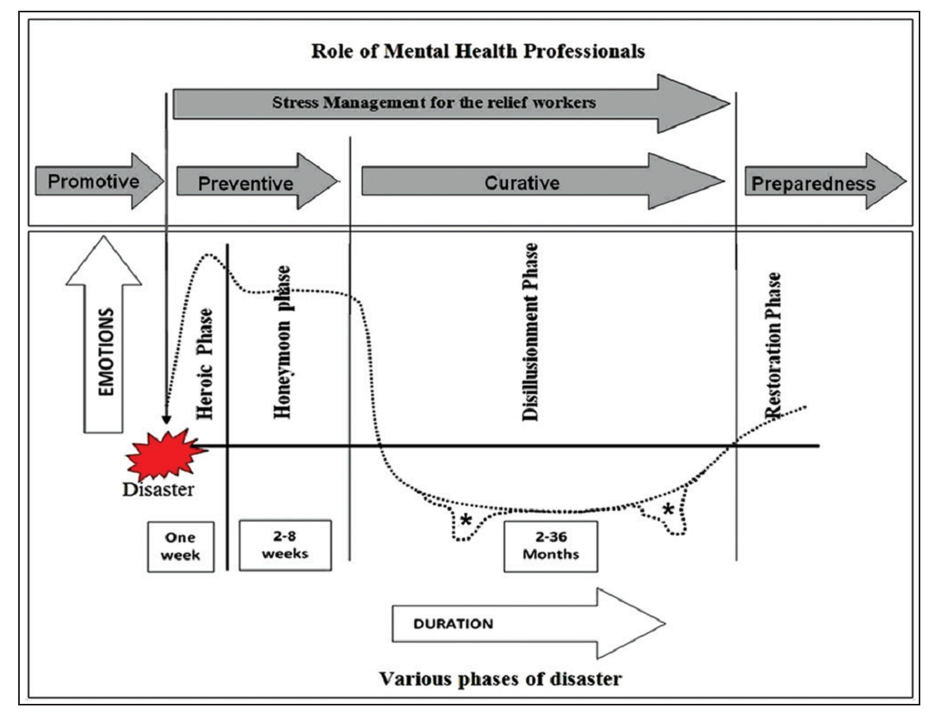
PHASES OF DISASTER

Slide 6
DISASTER MENTAL HEALTH
To apply psychiatric skills in recovering individual and community from the effects of a disaster.
Systematized, epidemiological approach to understanding and treating the psychological effects of mass casualties.
- (Norwood et al,2000)

Slide 7
PHASES OF DISASTER MENTAL HEALTH
The basic six ‘R’s of disaster management are
Readiness (Preparedness),
Response (Immediate action),
Relief (Sustained rescue work),
Rehabilitation (Long term remedial measures using community resources),
Recovery (Returning to normalcy) and
Resilience (Fostering).

Slide 8
THE DISASTER -DEVELOPMENT CONTINUM

Slide 9
ROLE OF MENTAL HEALTH PROFESSIONALS
Identifying and treating moderate – severe cases and prevention of adverse mental health consequences. [How?....]
Target the high risk group.
By training local resources.
Specialised care is required only in a small group of the population.
To assess the mental health of disaster relief workers throughout the disaster management phase.
To assess the basic infrastructure and provide feedback to the government for further development if required.

Slide 10
DIMENSIONS OF POST-DISASTER RESPONSE
POST DISASTER RESPONSE
EMOTIONAL
PSYCHOSOMATIC
COGNITION
BEHAVIORAL

Slide 11
TYPES OF RESPONSE TO TRUMATIC EVENTS
DISTRESS RESPONSE | HEALTH RISK BEHAVIORS | ILLNESS
 |  | Adults | Children
Fear Insomnia Grief/Sadness Anger/Irritability Confusion Somatic Complaints | Panic Increased Substance Use Domestic abuse Complex Bereavement | Acute stress disorder Depression Other Anxiety Disorders PTSD Substance-use disorders Somatoform Disorders Adjustment disorder | School refusal School dropouts ODD & Conduct symptoms Along with PTSD, Depression and somatoform disorder
Mental health morbidity continues to be prevalent even after 3-5 years in the disaster affected community. -(Liu A et al., 2006)

Slide 12
HIGH RISK GROUPS
Female gender & Children
Elderly
Physically disabled & chronic medical condition
Directly exposed to life threat
Injured & First responders
Displaced individuals with
• On-going negative life events after disaster
• Prior posttraumatic stress disorder
• Prior exposure to trauma
• Prior or current psychiatric or medical illness
• Lack of supportive relationships -(Math BS et al., 2015)

Slide 13
Factors contributing to the impact of a disaster
Economic status of the population
Population density
Limited resources with limited accessibility
Disaster increase the prevalence of psychopathology by approximately 17% on an average compared to pre-disaster control groups

Slide 14
CLASSIFICATION OF MENTAL HEALTH DISORDERS AFTER A DISASTER
ACUTE PHASE
1-3 months
Majority of the disorders are self limiting
LONG TERM PHASE
> 3 months
Most of the disorders requires assistance

Slide 15
PREVALENCE OF PSYCHIATRIC MORBIDITY
DISASTER SYNDROME:
It is characterized by stunned, dazed individual with apparently disengaged behaviour occurring in 25% (Freiderick,1981) to 75% (Duffy, 1988) of victims.
Girolamo of the World Health Organization (WHO) Mental Health Division has found that the prevalence ranges between 20% to 35% after a natural disaster.
.

Slide 16
PREVALENCE OF PSYCHIATRIC MORBIDITY
1st week - 70%
At 1 yr. - 30-40%
At 2 yrs. - levels are generally less but with persistent level of morbidity that seems to become chronic for some individuals and for some disasters.
At 10 weeks –
Significant Drop
Raphael (1986)

Slide 17
PSYCHIATRIC OUTCOMES
A literature based on review of series of empirical article on disaster, since 1981-2001, shown 77% of the sample had specific psychological problems.
Among them
PTSD 68% ,
MDD 36% ,
Anxiety 20%
-(Norris et al 2002)

Slide 18
PSYCHIATRIC OUTCOMES
Second set of outcome non-specific distress 39%
Features of depression
Features of anxiety
Chronic Problems in Living 10%
Somatic complaints
Disturbed sleep
Substance abuse
Troubled inter-personal relation
Psychosocial resource loss 9%

Slide 19
INDIAN SCENARIO
High prevalence of psychiatric morbidity in disaster survivor
Bhopal gas tragedy(1984)-22.6%
Latur earthquake (1993)-59%
Terrorist activity in Rajasthan (1996)-33.5%
Orissa super-cyclone (1999)-80.4%
Tsunami in costal Tamilnadu (2004)-27.2% psychiatric disorder & psychological symptom -79.7%
Andaman Nicobar tsunami (2004)-25-30% -(N Kar 2010)

Slide 20
INDIAN SCENARIO
DISASTER | DATE | DEATH TOLL | PSYCHIATRIC MORBIDITY | STUDY
BHOPAL GAS TRAGEDY | 2-3 Dec 1984 | 3787 | 22.6% diagnosed having mental illness Anxiety neurosis (25%), depression (20%) Adjustment reaction with predominant disturbance of emotions (16%) | Murthy et al 1997
ORISSA SUPERCYCLONE | Oct 1999 | 20,000 | PTSD – 44.3% Anxiety – 57.5% Depression – 52.7% | Kar N et al., 2004

Slide 21
DISASTER | DATE | DEATH TOLL | PSYCHIATRIC MORBIDITY | STUDY
GUJARAT EARTHQUAKE | 26th Jan 2001 | 20,000 deaths 1,67,00 injuries Destruction > 1 million homes | 80% had mental health problems 45.5% of patients attending PHC were having psychological distress score >6 PTSD 57.6% - Women 27.8% - Men 20% - Adolescent 43.8% - Teachers | Ramappa Bhadra 2004 Mehta at al., 2001
KASHMIR FLOODS | 6th Sep 2014 | 300 | PTSD, Depression and anxiety | Syed Amin 2015

Slide 22
INTERVENTION
Only 26.7% of those having severe symptoms are receiving treatment in spite of abundance of psychiatrist and mental health professionals. -(Lynn et al 2003)

Slide 23
HEROIC
&
HONEYMOON PHASE
Being a part of multidisciplinary relief team
Rapid assessment
DISILLUSIONMENT PHASE
Public education activities
Providing health care and targeted mental health intervention to the needy
Mental health education
Collaborating with administrative, funding agencies and local agencies
RESTORATION
&
PRE –DISASTER PERIOD
Providing care for mental ill patients
Attending to referrals
Training of resourceful community members
Community outreach camps
Assessment of intervention and feedback mechanism.
Disaster response Network
Training of trainers
Strengthening Information, Education and Communication (IEC) activities
Psychoeducation for the general population
Community level support and residence training
Stress management

Slide 24
Current status of pharmacotherapy
Benzodiazepine
No effect in preventing
Can increase PTSD
Beta blocker
Clinically ineffective in acute aftermath of trauma
Opioids
Some evidence of risk reduction

Slide 25
PSYCHOLOGICAL & PSYCHOSOCIAL INTERVENTIONS
Psychological first-aid
Debriefing
CBT
Trauma counselling
Community based intervention
Mitigating sufferings.
Notes:
community-based-group interventions can be planned like art therapy (painting/drawing), group discussions, dramas, storytelling, structuring their day, engaging in activities, prayers, yoga, relaxation, and sports/games; stress management of the relief worker is essential; engaging the willing survivors in spiritual activities and involving the survivors in re-building their community is essential.
There are no systematic studies, however preliminary research have yielded following resilience factors; a cohesive community, community resources, minimal displacement, good social support and network, preserved family system and support, altruistic behavior of the community leaders,

Slide 26
The effectiveness of psychological first aid as a disaster intervention tool: research analysis of peer-reviewed literature from 1990-2010. Fox JH¹, Burkle FM Jr, Bass J, Pia FA, Epstein JL, Markenson D.
Sufficient evidence for psychological first aid is widely supported by available objective observations and expert opinion and best fits the category of "evidence informed" but without proof of effectiveness.
No controlled studies were found.
There is insufficient evidence supporting a treatment standard or a treatment guideline.
Further outcome research is recommended.

Slide 27
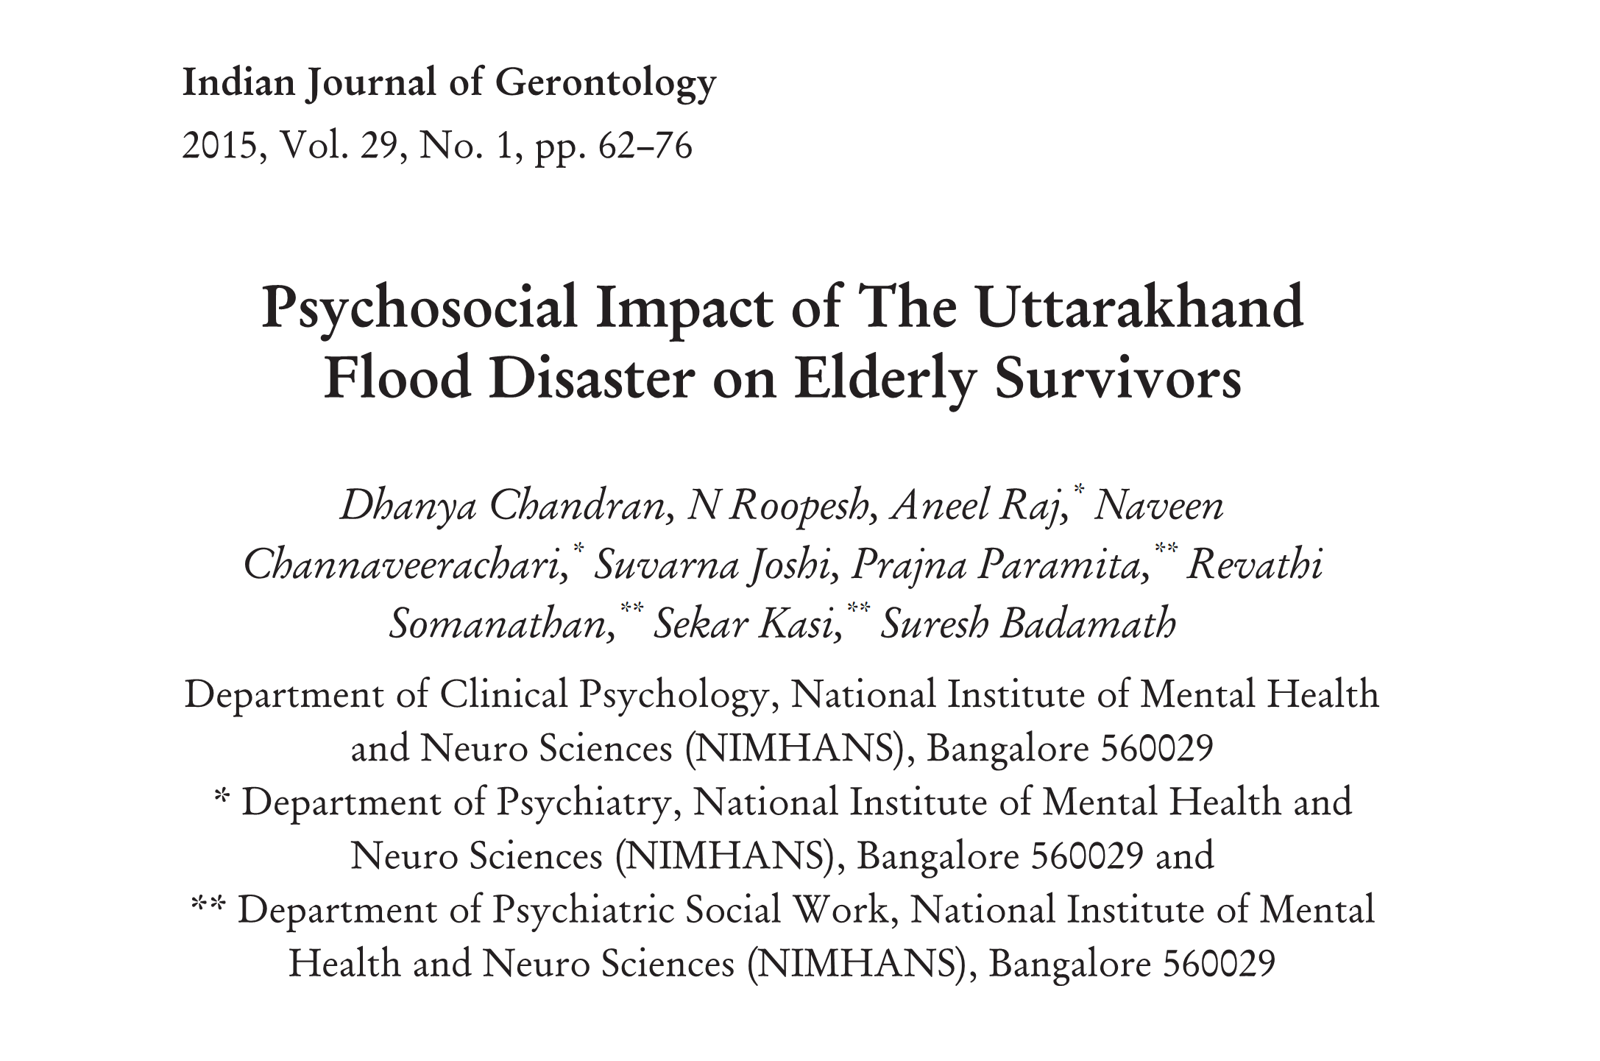

Slide 28
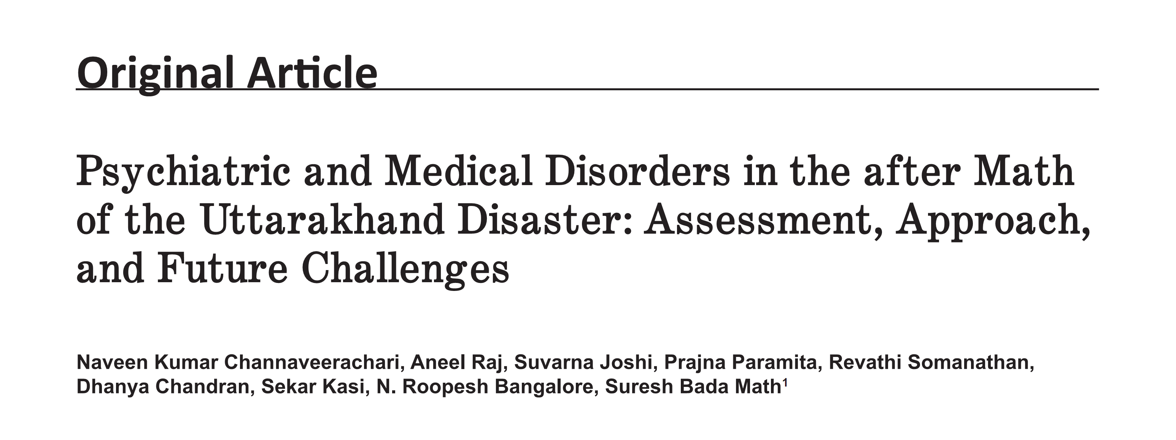

Slide 29
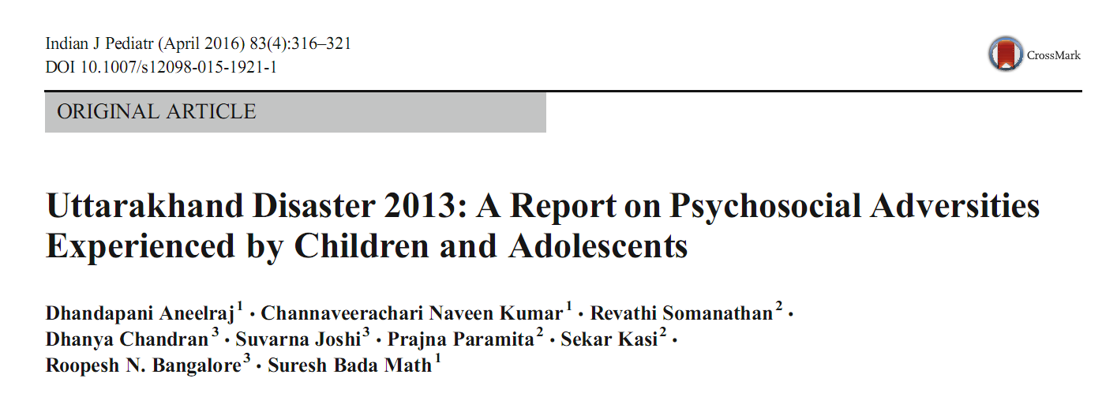

Slide 30
THANK YOU
draneelraj@gmail.com

